Slide 1
What Aviation Means to Our Economy
Here is your customizable template.
Make sure you look in the Note field below for a suggested script!
Delete yellow sticky notes from slides after you read the directions.
YOUR AIRPORT LOGO
[Your Name]
[Your Airport’s Name]
[Date of Presentation]

Slide 2
Agenda
Welcome
North Carolina: The State of Aviation 2023
Economic Impacts of [Add Your Airport’s Name]
Q&A
Notes:
Today, I’d like to share information about the North Carolina’s airports on our community and state, as well as what’s going on at [INSERT YOUR AIRPORT NAME]

Slide 3
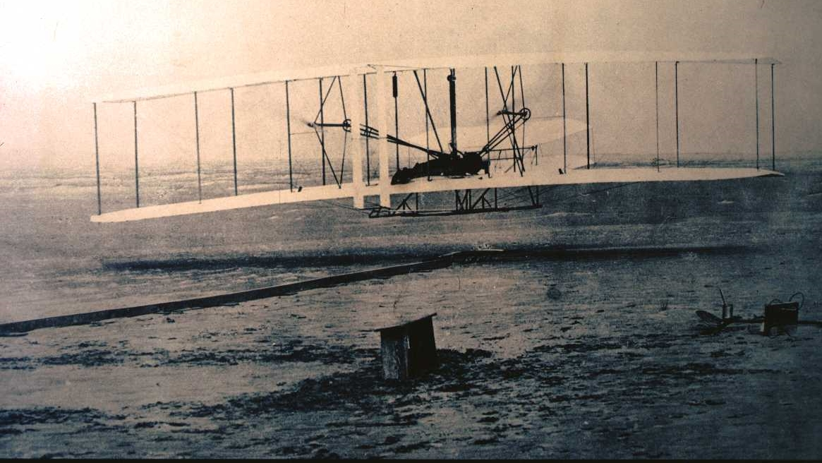
North Carolina: First in Flight
Notes:
As you know, North Carolina has been at the forefront of aviation since the Wright Brothers’ first flight at Kitty Hawk in 1903.
Today, the state’s network of 72 publicly owned airports, and the aviation and aerospace assets that rely on them, help move our economy forward by:
Creating jobs
Supporting business growth and
Connecting people and companies to markets around the globe.

Slide 4
N.C. Airports Annual Economic Impacts
Based on 2019 airport data
Notes:
A new report published in January (2023) by the N.C. Department of Transportation’s Division of Aviation quantifies the impact of our airports on the state’s economy.
The report revealed the results of an economic impact study showing that North Carolina’s public airports – of which [ADD YOUR AIRPORT NAME] is one – each year contribute more than:
$72 billion in economic output
330,000 jobs
$23 billion in personal income for those workers
$3.7 billion in state and local tax revenues.
That $721 billion represents a significant return on state and local investment in our state’s airports.
NCDOT creates the report every two years to help guide future investment in aviation infrastructure and provide a tool for recruiting aviation and aerospace industry companies and investment.

Slide 5
NORTH CAROLINA’S PUBLIC AIRPORTS
72 Airports | 10 Commercial Service | 62 General Aviation 96% of N.C.’s population lives within a 30-minute drive of a public airport
Notes:
North Carolina’s public airport system comprises 72 airports:
10 are classified as commercial service, meaning they offer regularly scheduled passenger service.
62 airports are classified as general aviation.
[YOUR AIRPORT NAME] is classified as a [TYPE] airport.
North Carolina airports:
Connect local businesses and communities to global markets
House and refuel private aircraft
Support military and agricultural aviation and statewide emergency response
And provide aviation services, such as aerial photography and pilot training.
Ninety-six percent of our state’s population lives within a 30-minute drive of a public airport.

Slide 6
Aviation Activity at N.C. Airports
Passenger Service
60 million annual passenger boardings
17 commercial airlines
15,000 airline jobs
$78,700 average annual salaries
Cargo Service
1.3 billion tons of cargo moved in 2021 – more than ever before
13 major cargo companies
$51,324 average wages
Notes:
17 commercial airlines move nearly 60 million passengers a year, connecting North Carolina travelers to destinations worldwide.
Passenger services at the commercial service airlines plummeted when COVID struck, but began rebounding in mid-2021.
The airlines employ nearly 15,000 workers that pay average salaries of nearly $79,000 a year.
North Carolina’s airports also handle more than 1.3 billion tons of cargo each year, from medical supplies to advanced manufacturing components.
Air cargo tends tend to be much higher value than cargo moved by other transportation modes – averaging nearly $50 per pound compared to rail at 17 cents per pound or truck at 56 cents per pound.

Slide 7
Airport Support Industries
10 rental car companies, contributing $74 million in tax revenues annually
4,000 based aircraft, contributing $5.6 million in aircraft tax revenues annually
523 million gallons of aviation fuel sold, contributing $10.7 million in tax revenues annually
Notes:
Airport-related businesses provide valuable support for airlines and airport customers and boost the state’s economy.
Ten rental car companies serve the state’s airports and generate more than $74 million in state tax revenues from an 8% tax on short-term leases and rentals of motor vehicles.
Aviation fuels sold at the airports serve the aviation industry and generate from nearly $11 million in tax revenues each year.
The revenues from fuel taxes are actually returned to the airport system as grants for aviation-related economic development projects that create jobs.
North Carolina also gains significant returns from the 4,000 private aircraft based at the state’s general aviation facilities.
They pay property taxes in some cases equivalent to those paid by an entire subdivision of homes.
[GIVE LOCAL EXAMPLE IF YOU HAVE IT, E.G.]
For example, the owner of a $23 million aircraft based at Statesville Regional Airport, for instance, pays local property taxes equivalent to those paid by owners of 115 homes valued at $200,000 each.

Slide 8
Aerospace Manufacturing
200+ aerospace companies
400+ aerospace supply chain companies
5,600 jobs
$99,944 average salaries
Notes:
Global professional services firm PwC ranked North Carolina sixth in aerospace manufacturing attractiveness in 2021 based on the strength of the state’s industry and economy.
Boeing, Cessna GE Aerospace, Honda Aero, Honda Aircraft Co., Lockheed Martin, Pratt & Whitney and Spirit AeroSystems are among more than 200 aerospace companies and 400 suppliers and vendors that call North Carolina home. [MENTION ANY LOCAL AEROSPACE MANUFACTURING IMPACT]
North Carolina’s aerospace sector employs 5,600 people. While sector employment declined 20% from 2019-2021 due to pandemic pressures, it grew at 13 times the national average from 2012 to 2021.

Slide 9
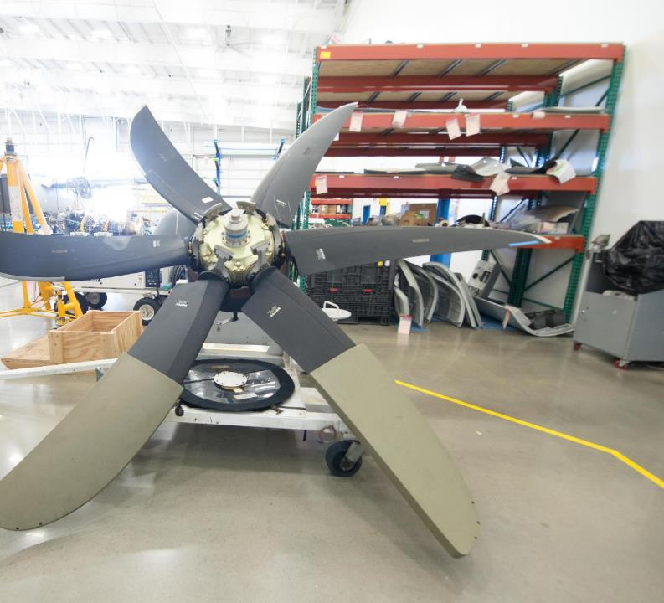
Aircraft Maintenance, Repair & Overhaul
174 companies
8,000 jobs
$68,120 average wages
North Carolina ranks 6th highest in the nation in MRO employment
Notes:
174 companies and 8,000 workers support North Carolina’s aerospace sector with critical maintenance, repair and overhaul, or MRO, services. North Carolina ranks sixth in the nation for MRO employment.
[MENTION ANY LOCAL MROs THAT OPERATE AT YOUR AIRPORT]

Slide 10
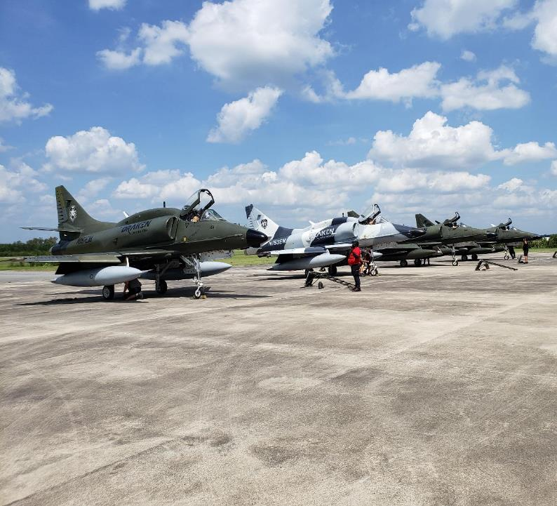
Military Aviation
8 military bases
156,000 employees
18,000 trained veterans exit service annually
Notes:
Synergies among North Carolina’s eight military installations, public airports and the companies that serve and supply them contribute significantly to the state’s economic growth.
Military aviators use public airports to conduct training operations, refuel and receive maintenance and repair services, which drive local business activity.
And importantly, more than 18,000 skilled civilians and veterans leave the military each year, providing experienced talent for the state’s aviation workforce.
[MENTION ANY IMPACT AT YOUR AIRPORT FROM MILITARY AVIATION]

Slide 11
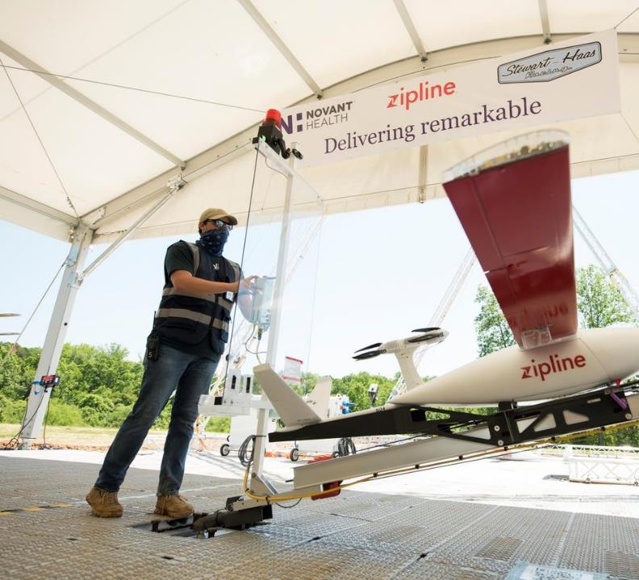
Uncrewed Aircraft Systems (UAS, or Drones)
240 UAS companies
N.C. leading the way in drone medical delivery, backyard food delivery, transportation infrastructure inspection
Notes:
Uncrewed aircraft systems, (UAS, or drones) offer the potential to transform how we live and work but require a complex system of infrastructure and regulation to do so.
North Carolina has been at the forefront of developing such a system since 2014 and continues to achieve significant advances in drone use for business and government purposes.
This photo shows Zipline, a company operating in Kannapolis, that uses drones to drop medical packages on 26-mile round trips.
These successes are bringing a growing companies to North Carolina that are involved in developing or using drones to support their operations, and we expect that trend to continue.

Slide 12
Aviation Education
20,500 STEM post-secondary graduates annually
4 universities with BS+ in aviation-related fields
7 community colleges/ 1 private college with associate degress, diplomas, certificates
28 community colleges with aviation workforce content
Notes:
North Carolina’s higher education system provides strong support for aviation, with more than 28 degree programs relevant to aviation and the aerospace sector.
More than 20,500 students graduate with STEM-related degrees from North Carolina institutions each year to support the state’s aviation talent pipeline.
[MENTION HOW EDUCATIONAL INSTITUTIONS IN YOUR COMMUNITY SUPPORT AVIATION, IF THEY DO]

Slide 13
Annual Economic Impacts of [Your Airport Name]
[CUSTOMIZE THIS SLIDE BY FILLING IN YOUR IMPACT DATA; add a photo of your airport]
$ XXX economic output
XXX jobs
$ XXX personal income of workers in those jobs
$XXX state and local tax revenues
Notes:
[Add Your Airport Name] also contributes to our state and local economy.
The latest economic impact study reported that [YOUR AIRPORT NAME] each year contributes more than:
$XXX in economic output
XXX jobs
$XXX in personal income from those jobs
And $XXX in state and local tax revenues

Slide 14
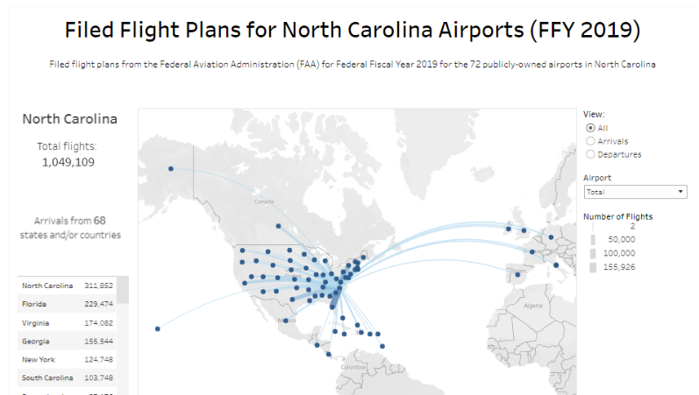
Your airport connects people and goods to global markets, driving economic growth
Go to go.ncsu.edu/airportarrivalsanddepartures and use the menu to find your airport and generate a flight plan dashboard for your airport that looks like this.
Take a screen capture and replace this image with your own, showing flights to and from your airport in a given year (based on federal fiscal year 2021 data).
OR embed the animation provided by ITRE on Jan 6, 2023
Notes:
[Use the new Filed Flight Plan Dashboard to show the reach of flights from your airport and place it on this slide]
This dashboard shows all of the places that planes fly in and out of our airport during the year.
We connect people and goods to the global marketplace.
[SHARE WHAT YOU KNOW ABOUT THE COMPANIES FLYING TO DESTINATIONS]
This activity creates significant economic impact in our community.

Slide 15
Supporting the Community and the Economy
[CUSTOMIZE AND ADD IMAGES IF YOU LIKE, OF THE WAYS YOUR AIRPORT SUPPORTS YOUR COMMUNITY AND ITS ECONOMY]
Aerial agricultural applications
Aerial firefighting
Aerial ambulance
Air Taxi / Passengers on-demand
Air tours
Business / corporate use
Disaster relief
Drug enforcement
Flight instructions
Overnight packages
Personal / Recreation
Power line inspections
Search and rescue
Traffic advisory
Transporting human organs
Weather observations
Wildlife management
Notes:
[Highlight the many ways your airport support the community and its economy.]

Slide 16
Airport Infrastructure Development Projects
OPTIONAL – HIGHLIGHT THE DEVELOPMENT PROJECTS UNDER WAY OR PLANNED AT YOUR AIRPORT
Notes:
[OPTIONAL: Highlight recent, current and planned airport projects that support your economic impact. The script can say something like this:]
The new _____________ moves the airport’s master plan forward and prepares us for continued growth in utilization. (Explain)
By prioritizing this/these significant project(s) now, we are positioning the airport to attract additional air service to our community in the future.
The airport will be able to attract an additional ______ tenants after this construction is complete, contributing up to $_____ more to the annual operating revenues.

Slide 17
Questions?
Notes:
Thanks again for the opportunity to share with you how your state’s public airports are supporting this community and our state.
I’d be happy to answer any questions.

Slide 18
Thank you for your support of aviation in North Carolina and [Your Airport Name]!
YOUR AIRPORT LOGO
Contact:
YOUR NAME
YOUR TITLE
YOUR AIRPORT NAME
PHONE NUMBER
EMAIL
WEB ADDRESS
Notes:
We appreciate the support this community gives to the airport.
Please feel free to contact me if you have questions or connections with aviation-related businesses that can help us expand our impact even more.

